Slide 1
Current Topics Project
By Sam Boyd, Rachel Peterson, and Miranda Franyovich

Slide 2
Young scientists (K-12) in the news
For our current events topic we decided to research young scientists who were within the grades of kindergarten and 12th grade.
We ended up having a hard time finding young scientists, let alone intresting ones, but in the end, we came across good kids with amazing ideas.

Slide 3
1st Scientist; Peyton Roberston
Peyton is 11 years old from Fort Lauderdale, Florida.
Peyton attends Stanford University’s Middle school
Peyton won the, “Discovery Education 3M Young Scientist Challenge” with his creation of the sandless sandbag

Slide 4
Peyton’s Invention
Peyton invented the sandless sandbag to help prevent damage from hurricanes and super storms.
His invention was designed to save money and even lives during storms
Instead of filling the bags with sand, he filled them with an ultra-fluid polymer

Slide 5
Peyton’s Invention (cont.)
These bags only weigh one to two pounds when dry, versus the typical 50 pounds
The polymer and salt that is used in the sand bags only expands when it is drenched in water, explaining why it is so light in weight
The bags also do not float away after they have soaked up water because the polymer has expanded and weighed down the bag.

Slide 6
Peyton giving a presentation on normal sandbags versus his.

Slide 7
2nd Scientist; Adeeb Al Balooshi
Adeeb is 10 years old and goes to school Gems Wellington International School
Adeebs invention of the waterproof prosthetic leg is deigned to help people with protsthetics for their legs, be able to enjoy water activities
His invention of the housework robot is designed to help his mother clean in an easier way and save them time

Slide 8
Adeeb Al Balooshi’s invention
At 10 years old, Adeeb completed a seven country tour for his invention of the waterproof prosthetic leg for his dad and a robot that completes housework for his mother.
Adeeb found inspiration for the waterproof prosthetic leg for his father when they would visit the beach and his father couldn’t swim with him and the rest of his family

Slide 9
Adeebs invention (cont.)
He created the housecleaning robot in less than one day
It is designed to sweep the floors and clean the couch of crumbs
The robot was made of a broom that can vibrate, a vibrating motor, and feathers. All together, the device can do simple housework.

Slide 10
Adeeb shows how to use his invention of the waterproof prosthetic leg

Slide 11
3rd Scientist(s); 30,000 UK schoolchidren
30,000 schoolchidren from 400 different schools across the UK took part in a science experiment involving bumble bees
Scientists in the UK realized that the amount of bumble bees in major cities were very low
So, schoolchildren studied different kinds of flowers and plants, in different environments, and took record of how many bees were spotted during the study.

Slide 12
3rd Scientist (cont.)
From the studies, they learned that more bees were spotted on lavender plants, and of those lavender plants, the ones in urban environments attracted more of the black and yellow pollinators.
There we also many bees found where lavender and other flowers were planted.

Slide 13
3rd Scientist (cont.)
So, why are bumble bees so important?
These bees are prolific contributors to the pollination rate of crops
Its believed that environmental changes are reducing the population of the bees as well as their effectivness to pollinate
All of this means that the less bees we have, the less flowers and plants we have due to less pollination

Slide 14
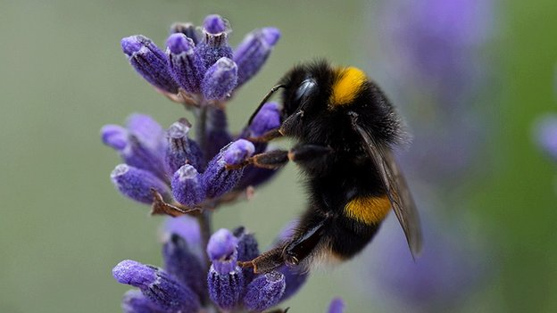
Bumble bee and lavender

Slide 15
The Scientists mission
Each of the young scientists researched and talked about in the presentation created and/or researched things to help people around them and find solutions to everyday problems.
The only thing left to know more about is how the inventions are helping different people around the world.

Slide 16
Resources
bbc.com
Thenational.ae
Google images
Abcnews.com

