Slide 1
Dialysis
Rachel Peterson, Sam Boyd, Miranda Franyovich, Cosette Seidenberg

Slide 2
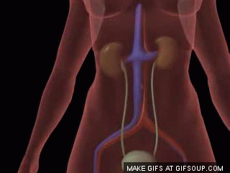
Where is urine produced in the body?
kidneys
the kidneys produce urine by taking the toxins out of you blood

Slide 3
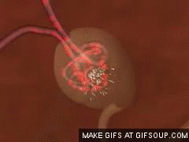
How is urine produced in the body?
the kidneys are able to take out the toxins in your blood by
- filtering the blood
the toxins are
- urea
- ions (salt)
- ammonia

Slide 4
What is the process of removing waste?
cells produce waste from cell respiration
this waste is exerted into the blood and is filtered through the kidneys out to the urine

Slide 5
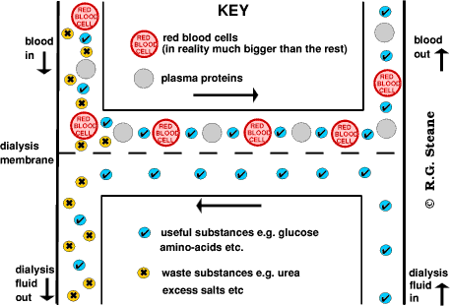
How does Dialysis remove waste?
Cell waste is released into the blood.
The blood is pumped out and through the dialysis machine which filters the blood.
The newly filtered blood is pumped back into the body

Slide 6
What is urine?
Urine is fluid waste that is excreted by the kidneys.
Urine is 96% water and the other 4% are the waste products such as urea and salts

Slide 7
Where do molecules in urine come from?
The first step of urine formation is filteration blood plasma at the nephrons. In the nephrons, cells, proteins, and other large molecules are filtered out of the glomerulus by the process of ultrafilteration, which leaves an ultafilerate that resembles plasma to enter the Bowman’s space.

Slide 8
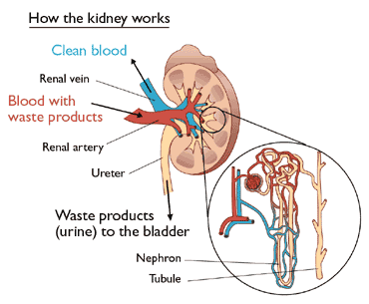
Example of that process

Slide 9
What would happen if we could not get rid of those molecules into the urine?
If the urine isn’t filtered, you would have blood, plasma, protein, and other large molecules be the contents of your urine. This is harmful due to the fact that they are deadly to your body and could end up poisoning you in large quanties.

Slide 10
What happens if kidneys fail?
When the kidneys fail, your body fills up with extra water and waste products. The products can be very harmful the body and this condition often goes by the name of Uremia. Having this condition may cause hands or feet to swell, and you will feel tired and weak due to your blood not being cleaned properly.

Slide 11
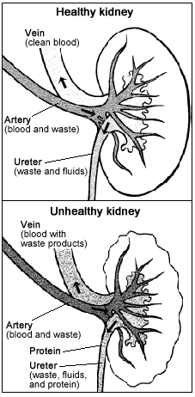
Example of a good kidney vs. a bad kidney

Slide 12
So what is Dialysis?
Dialysis is the process of removing waste and excess water from the blood and is used primarily as an artificial replacement to loss of kidney function, usually due to renal failure.

Slide 13
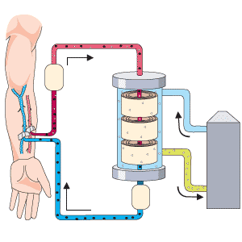
Example of Dialysis machine

